Slide 1
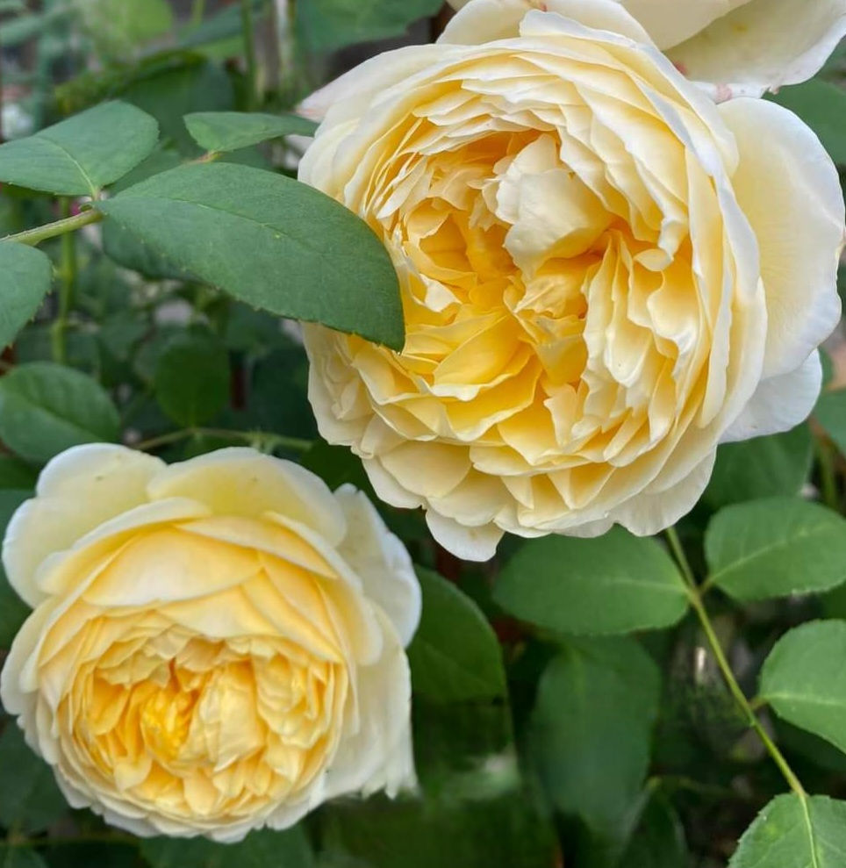
FALL ROSE CLEANUP
IN SOUTH FLORIDA
Denise Abruzzese, Mike Becker, William Langford,
September 2025

Slide 2
OVERVIEW OF ROSES IN SOUTH FLORIDA
1. LIGHT FALL PRUNING
2. INSPECT FOR DISEASES, PESTS
3. CLEAN UP BEDS
4. ASSESS LOCATION OF EACH BUSH FOR LIGHT AND POSSIBLE MOVE
5. ORGANIC MATTER
6. FERTILIZING
7. ADJUSTING WATER
8. REPAIRING CANES

Slide 3
Light Fall Pruning
Sharpen your pruners. The cuts you make while pruning should be sharp and clean. If they are not or it is difficult to cut a cane, try sharpening (or replacing) the blade on your pruners. It is also highly recommended that you disinfect your pruners between pruning each different bush so you are less likely to spread disease between bushes. This can be done with spraying the blades peroxide, alcohol or with Lysol TM or using Lysol TM wipes. Do not use bleach, as it can damage steel pruner blades. It is a good practice to clean, dry and store your pruners (inside).
When you prune, do so just above a 5-leaf cluster (choosing an outward facing bud eye), no more than 1/4" above the bud eye that is at the base of the leaf cluster. If more than 1/4" of stem is left you often will get dieback that can continue down the stem. Usually, in the fall, it's best to lightly prune a few inches off the height of the bush. You just want to shape and take down a little of the height and/or width. Remove any dead, dying or diseased canes. Remove any crossing canes. Remove canes that are thinner than a pencil. Seal the cut canes. You can use cane sealer or elmer’s glue. Try not to get any glue on the bud eyes. If you have a lot of stems left (which will be the case with some varieties) you should concentrate on sealing the larger canes and don't bother with the smaller ones. Just make sure that you are not expecting rain when you do the sealing, as the glue will wash away if it has not had time to dry. For climbing roses prune all lateral canes to two or three bud eyes. For main canes you should prune any dead, diseased or dying main canes or canes growing in the wrong direction. If you have too many main canes, prune off the oldest ones.
Remove diseased foliage and discard. All cuttings and leaves should be put out for collection and not left in the rose bed or put in a compost bin. They can be harboring disease or unwanted pests, which you do not want attacking your new growth.
Do not prune once bloomers until after they bloom. Do not prune roses that are less than one year old except for dead and diseased canes. Some older garden roses do not like pruning. An example of this would be Mrs. BR Cant. You should only lightly shape the bush and remove dead or diseased canes. You will have blooms 5 to 7 weeks after you prune.
During the growing season, you should always pinch off blooms to encourage new blooms to grow or you can prune down to the first or second 5 leaf node. You should always remove dead, dying, diseased or die back (blackening) canes through out the year.

Slide 4
Diseases/Insects
Inspect your roses and leaves for signs of diseases, insects, etc.
Most pests can be eliminated with spraying such as Captain Jacks Dead Bug Spray. There are exceptions. The alternative is to release predator insects such as lacewings, ladybugs and pirate bugs. Also releasing good nematodes in the soil will help lessen the bad nematodes in the soil. A good source of these predator bugs is Arbico Organics. Make sure to release predator bugs at night when the dew is on the roses.
Aphids: These are little green insects that suck on new buds and new growth. They can be squished with your fingers if there are just a few. Use an insecticidal soap if they are found in large numbers.
Chili Thrips Chili Thrips are minute bugs and show by the crinkled leaves with brown marks underneath and buds that won't open and brown. As the weather cools down, the thrip activity will decrease and in warmer weather they will their life cycle is shorter. If you need to treat them, the best choice is Conserve rotating with a product like Merit. This insecticide routine is effective on Chili thrips, but you should apply it early morning or late in the day, when bees are not active. An alternative would be a ground drench of imidocloprid. It's safer for bees.
Gall (Crown & Root) Crown gall presents as a cauliflower like growth on the rose. Root gall presents in small growths on the root of the rose which can also show as inflamed roots. These are highly contagious and the rose must be bagged and thrown out. You cannot plant another rose in the spot without solarization of the soil for 3 months. All tools must be bleached so as to not spread it.
MealyBugs This are horrible white bugs that adhere to the canes. You can kill them with 70% alcohol. Sometimes you may need to scrub the cane with a brush.
Scarab beetles In April, you may notice beetles in the blooms. They can be knocked off into a jar of water with a little Clorox added. (Or they can be squished between petals or rose leaves). April is often dry and sometimes you will get a infestation of spider mites later in the month. They live on the underside of the leaves and are very small. If you have them, the leaf will start to lose color and feel gritty or sandy on the underside. A hard blast of water to the underside of the leaves will control them. This should be repeated several days in a row, or every other day for about 3 days, then once a week until the rains start. You can also use the Imidocloprid drench to kill them while they are grubs in the ground. I would do this in March
Spidermites Spidermites thrive in dry conditions, but you can control them with a hard spray of water to the undersides of the leaves. If you have leaves that are a light green, or grayish, shake the leaf over a white sheet of paper. Using a magnifying glass, you will see the tiny spider mites. If you have an infestation, do the water spray every other day for three treatments.

Slide 5
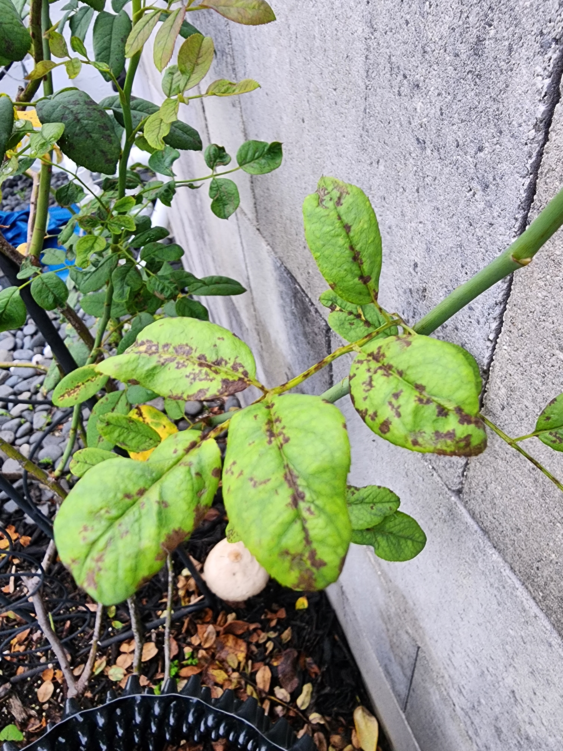
Diseases/Insects
Blackspot Keep up with your weekly fungicide spray program. Do not use horticultural oils when it is over 80 degrees. Spray early in the morning or late in the evening to avoid spray burn. Alternatively, you can use cornmeal. Approximately, 1/2 cup around the base of the rose and water in. Use every 3 to 4 weeks. Pull off blackspot-infected leaves whether you spray or not (this should be done year-round) and throw them in the garbage. Pick up all fallen leaves to stop the spread. RIGHT: EXAMPLE OF BLACKSPOT
Powdery Mildew This can happen during dry season. You can use a diluted whole milk spray every few days to eradicate this.

Slide 6
CLEAN UP THE BEDS
Clean up the beds to lessen the chance of diseases and pests.
Pull weeds
Remove fallen leaves
Remove deadheaded flowers
Remove fallen canes and branches
Till the soil
Add weed preventer

Slide 7
ASSESS LOCATION OF EACH BUSH
Fall is the time to check each bush’s location to make sure the bush is happy. Does it need more shade? More Sun? More Space?
If you need to move the bush, you should do a hard prune and water thoroughly the day prior to moving. Dig as much of the roots out as possible.
We are now zone 11A. Roses generally need 6 hour minimum of full sun. In South Florida some roses can take all day full sun. But many need 4 - 5 hours of morning sun and afternoon shade. So keep this in mind when choosing your new location. I have many roses that are planted underneath palm trees so they get filtered sun all day. There are some roses that may also thrive in the shade. You can look up any rose characteristics/requirements on helpmefind.com
After choosing your location, dig a hole 20" x 20". Keep in mind roses need airflow so when planting, plant from 3 to 4 feet, on center, apart from each other.
After relocating the rose, give it a deep watering at the base of the plant. You can add superthrive to prevent transplant shock. Make sure you add manure to the soil, bone meal and mycorrhizal fungi for root health and stimulation. Do not use non organic fertilizers at this time.
Roses on Fortuniana need to be staked because of high winds and shallow roots. It’s best to use metal rebar so it will not rot.

Slide 8
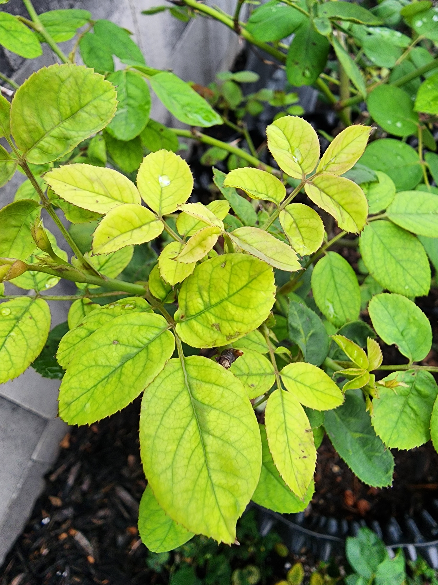
SOIL: Now is a good time to test and amend your soil after the heavy rains.
Amend your soil! Most rosarians say to remove 50% of what you dig up and mix the remaining amount with your soil mix. I it all and mix potting soil, manure and compost. I also add a 2 inch layer of peat moss to help resist nematodes.
Feel free to add manure, compost, worm castings, blood meal, bone meal and, most importantly, crab meal to ward off nematodes which feed on the roots of roses. Amending your soil is one of the most important parts of growing roses as our sandy soil lacks nitrogen and many other nutrients.
Mound your soil so the roots spread out around and sprinkle mycorrhizal fungi on the roots when planting. This strengthens the roots system. If you use this, do not use a fungicide in the ground like a drench.
PH: Roses like a PH of 5.5 to 6.5. My preference is 6.0. If the PH is too high, nutrients cannot be up taken to the canes. Use your PH tester on a regular basis! To lower PH use potassium sulphate, sulphur. Sometimes rainwater will lower it as well. To raise PH (which almost never happens in South Florida) use baking soda or volcanic ash.
RIGHT: Example of High PH which inhibits nutrient uptake.

Slide 9
FERTILIZER
You can add a long term granular fertilizer if you like. If you add a 6 month fertilizer, in rainy, hot Florida, it will last only 3 months. The cooler months of fall are the perfect time to add long term fertilizer.
Liquid non-organic fertilizers can also be used at this time if that is your preference, like Miracles Grow, Peters, etc.
You can use organic fertilizers, liquids, etc. Fish Emulsion, Kelp, Epsom Salts, Max Sea 16 16 16, Alfalfa Tea, etc.
If you want a fast flush of roses, add banana water about 2 weeks prior to when you want the flush.

Slide 10
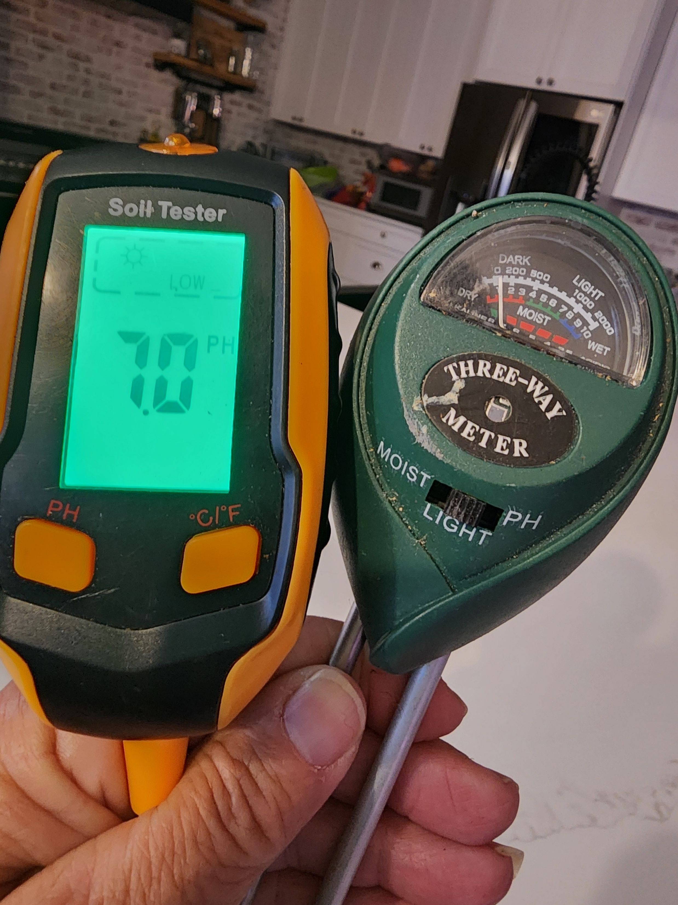
Water
Use a water meter to test your water level.
If you grow roses in pots, remember that while they have to be watered daily in the summer months (sometimes twice a day), in late fall and winter, only water every other day. Water when soil is dry and water deeply to encourage strong root growth. Think 1 - 2 gallons per rose.
Remember though to always water prior to fertilizing..
Adjust the timers on all of your sprinklers or drip lines. Keep in mind we are coming out of rainy season and will head to dry season soon so adjust accordingly.

Slide 11
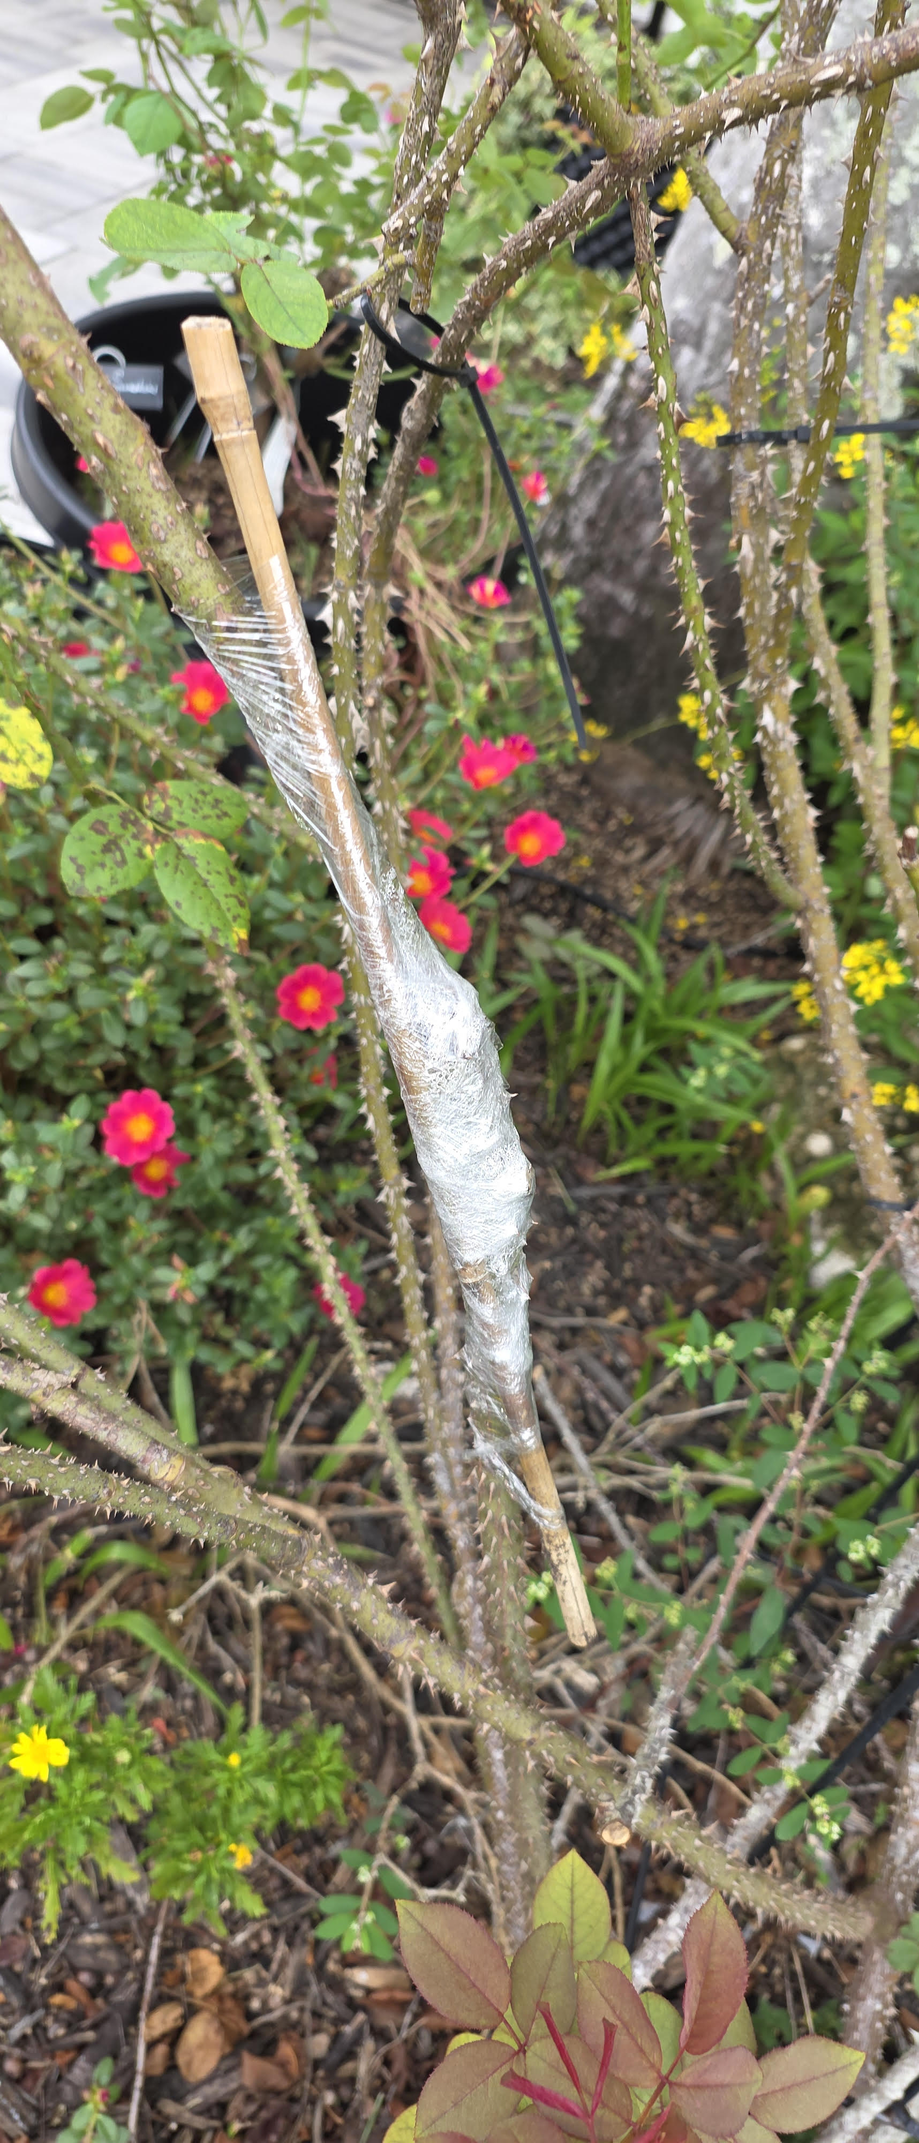
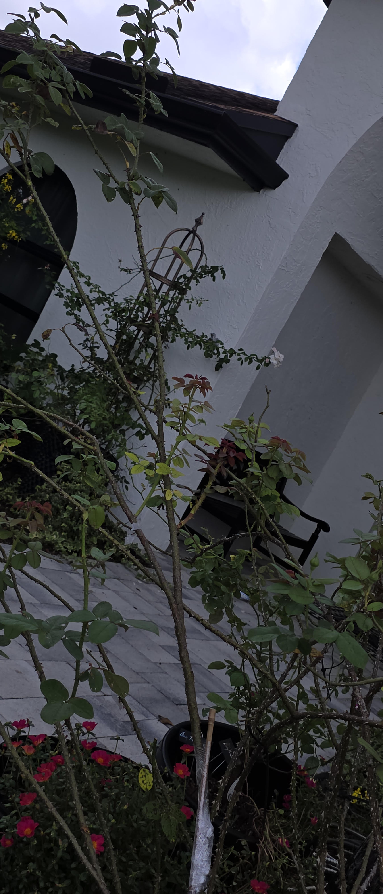
Repairing Canes
We have all been there! We accidentally broke a cane or the wind partially tore one off. Yes! You can fix it! Once repaired, it will take about 4 to 6 weeks to callous over and stabilize.
You will need the following items:
Scissors
Grafting Tape
Bamboo sticks
We will have a demonstration.
Right: Repaired Tess d’Tuberville Rose

