Slide 1
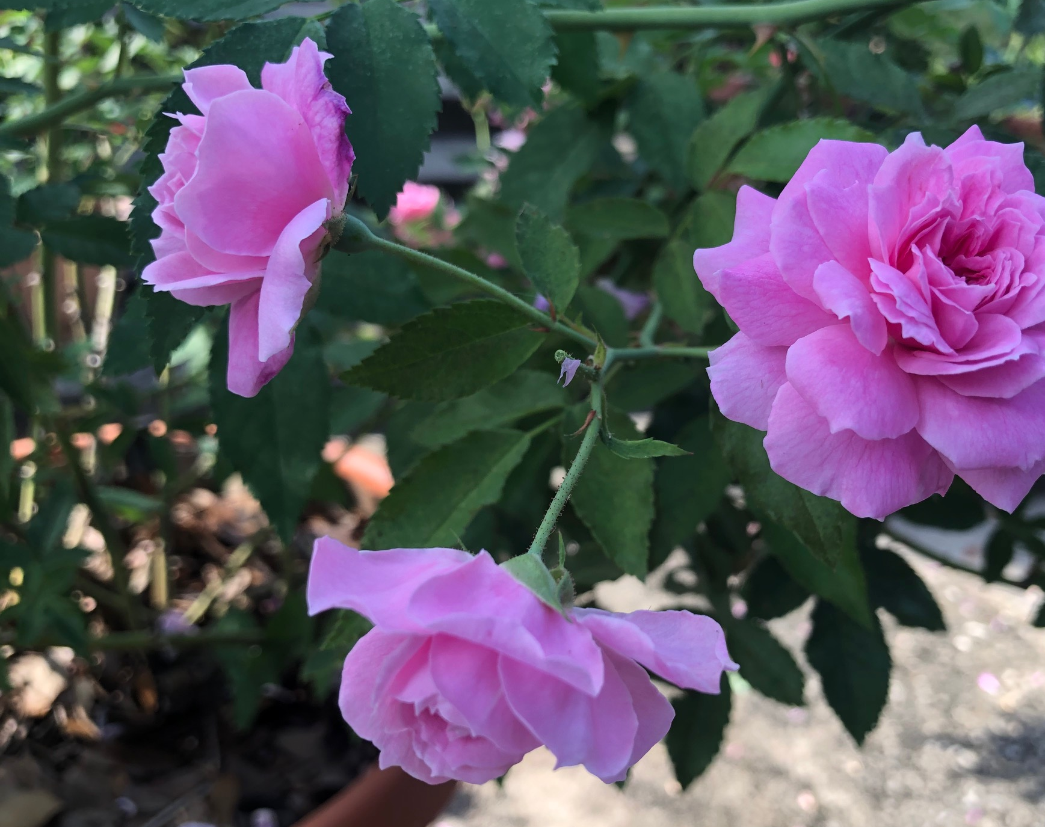
Growing Roses in South Florida
Bill Langford
Greater Palm Beach Rose Society
WHL2@prodigy.net
GPBRS.org

Slide 2
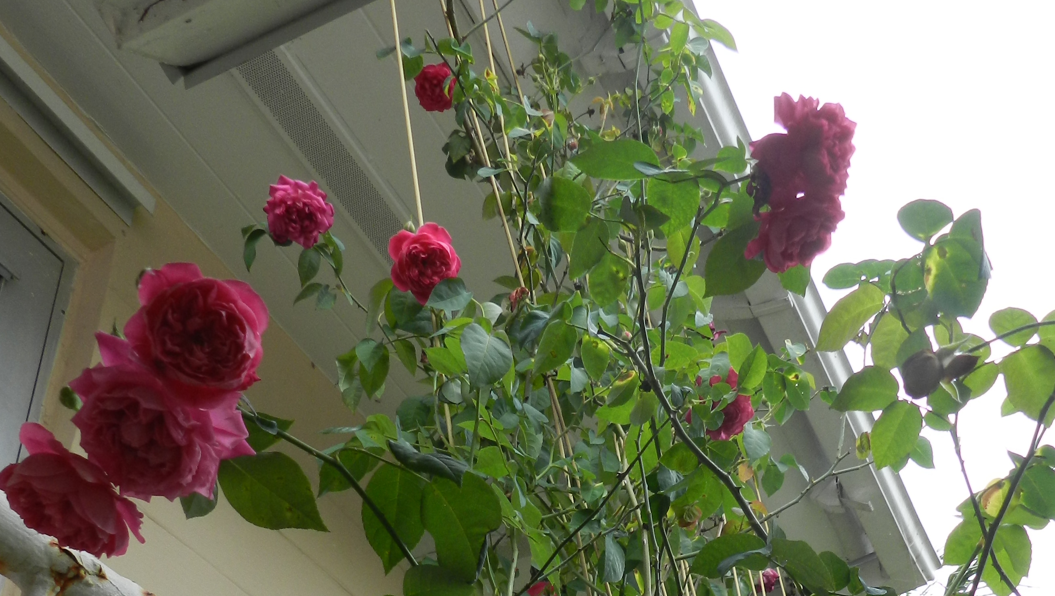
Growing Beautiful Roses in S. Florida
Select the Right Rose.
Consider the best location.
Prepare the soil.
Water, water, water.
Feed your roses regularly.

Slide 3
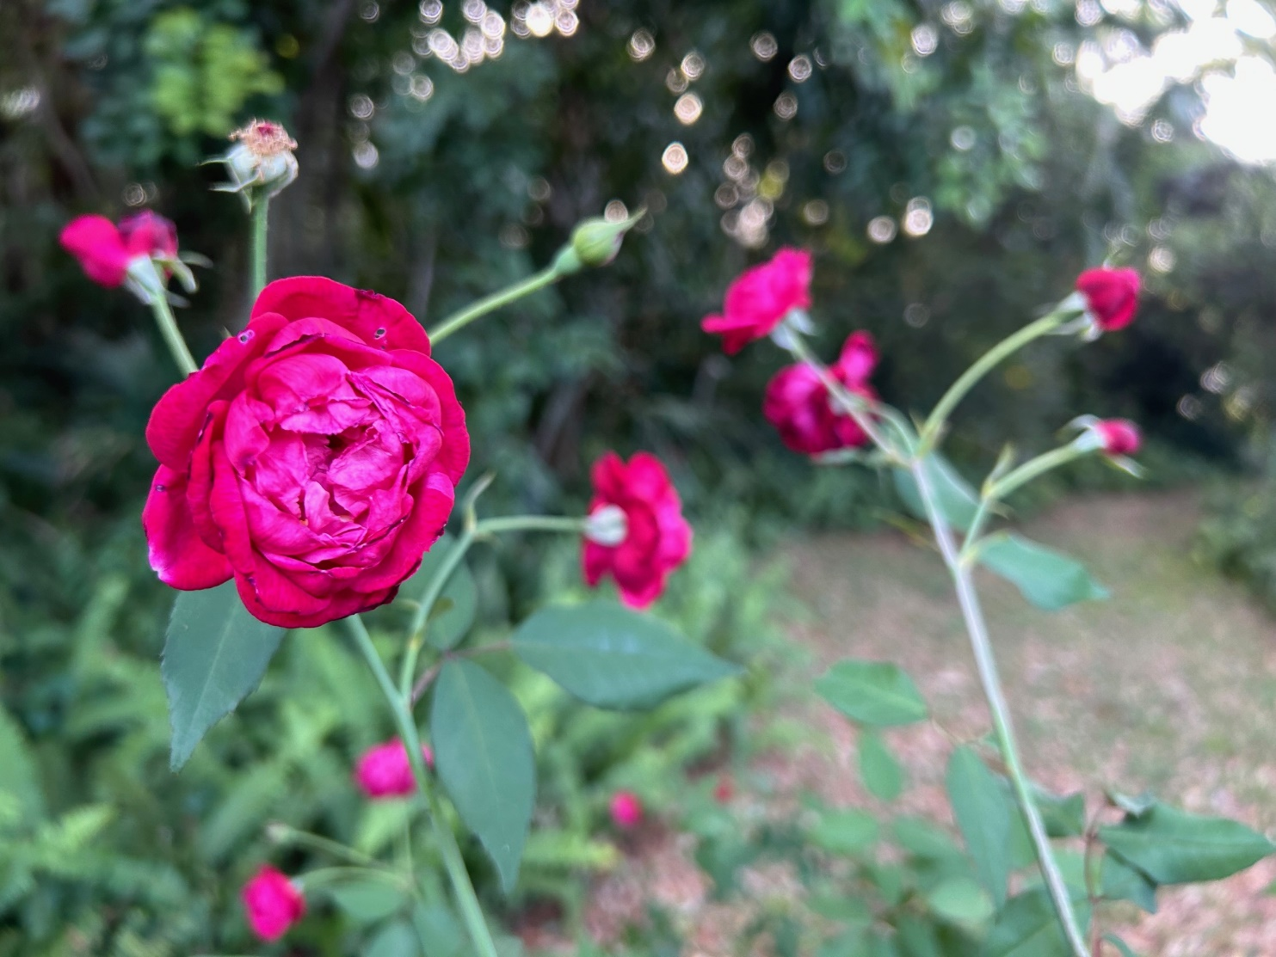
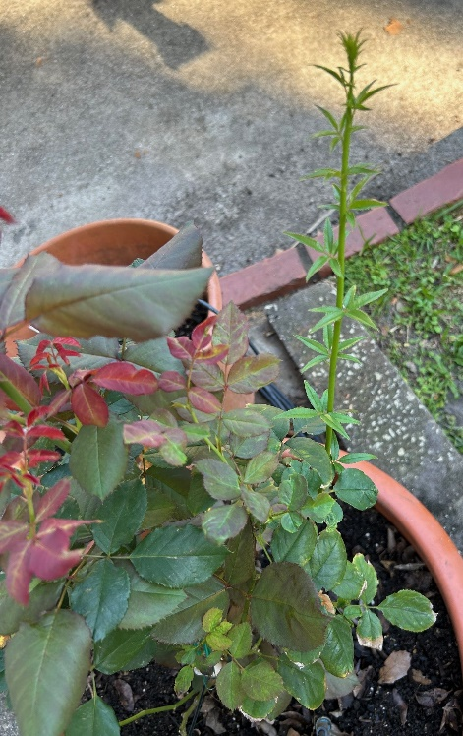
Select the Right Rose
Not all roses are created equal. Some are hardier and more disease resistant than others.
Buy quality roses that are highly disease resistant. Hybridizers are now focused on developing new disease resistant varieties.
Many own-root old garden roses do well.
If you buy grafted roses, look look for ones with Fortuniana rootstock.
Local rose societies are good sources for learning which varieties are best for your area.
Louis Philippe (aka Florida Cracker Rose)

Slide 4

Right Location
Whatever rose you select, plant your rose in a location that gets plenty of sun.
Roses need at least 6 hours of direct sun to grow to their optimum. More sun is good, but less sun means your rose will produce fewer blooms.
Remember that the sun is lower in the sky during the winter, when days are shorter, so make sure the roses get sun in the winter months.
You buy roses for the flowers, so it makes sense to plant your rose bush where it will get plenty of sun.

Slide 5


Slide 6
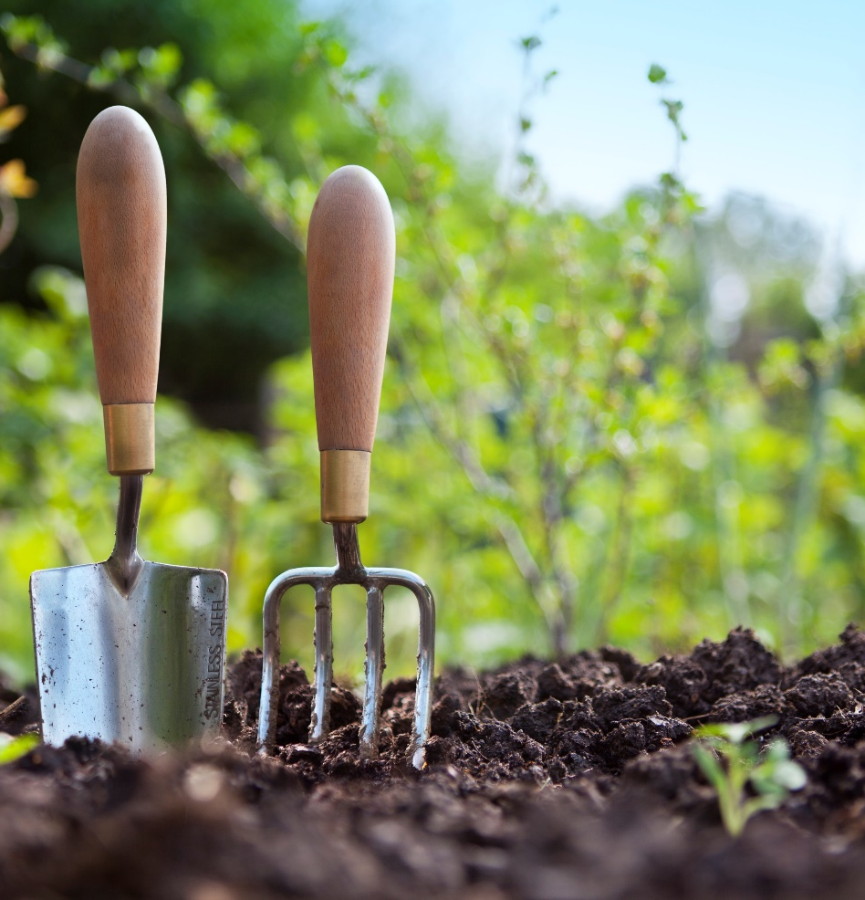
Good Soil
Although there are several locations in Florida with primarily clay-based soil, by far most locations in south Florida are mostly sandy soils…almost too much sand.
Regardless of which type of soil you have in your garden, it is likely that it needs to be amended with quality composts, peat moss, potting mixes or other organic materials. A rule of thumb is to use 50% of the natural soil and 50% amendments. Adding these creates better soil compositions that provide good drainage while providing for good soil moisture and nutrient retention.
This means a better growing medium and ultimately, healthier roses.

Slide 7
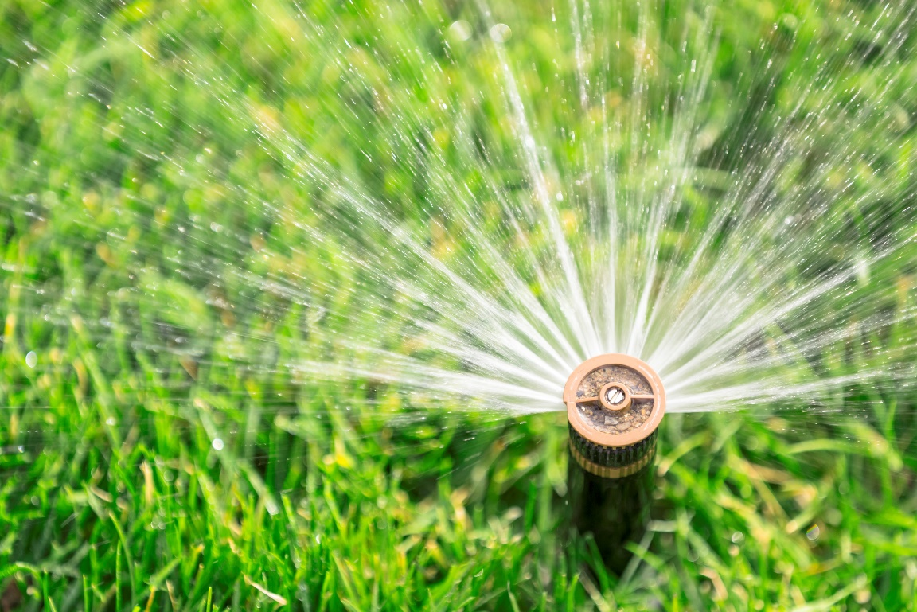
Water, water, water
One of the most important things you can do for your roses is to keep them well hydrated, especially in our hot south Florida climate. That means you should water on a regular basis.
Roses do not like their feet too wet, but they do like it moist with a regular supply of water. If your yard does not drain well after heavy rains, you may want to consider a raised bed for your roses.
How much water you give them will depend on the weather, how porous your soil is and the time of year. During rainy periods you will need to add much water, but during dry spells irrigation is a must.
A drip system is a great way to water, it keeps the leaves dry and conserves water.
A thick layer of mulch will help retain the water in the soil and also helps keeps weeds at bay.

Slide 8
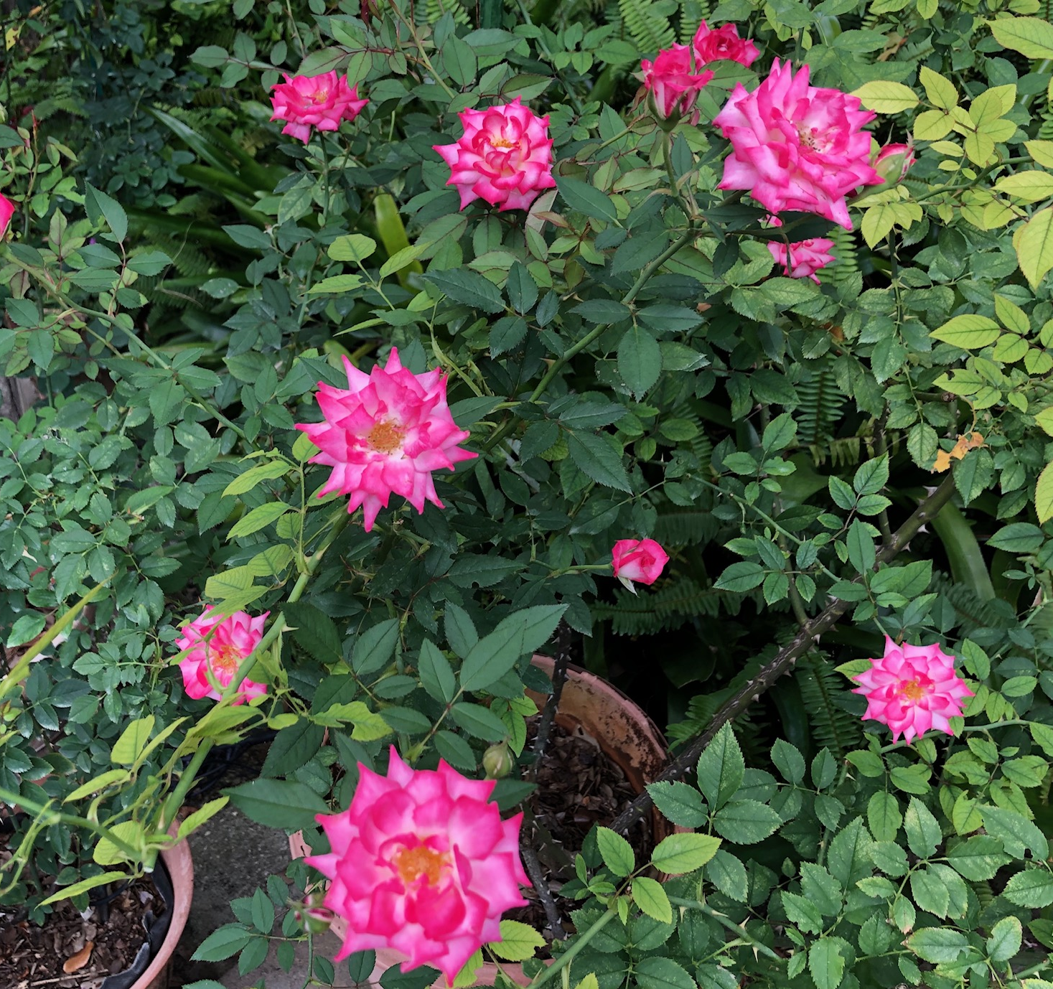
Feed Regularly
We all like to eat and so do roses. Roses are heavy feeders. It takes a lot of energy to produce a bloom, and to produce so many blooms throughout the year in south Florida roses need a regular supply of nutrients.
Although a quick feed with chemical fertilizers can do the trick in the short-term, but they also require more frequent application. A better application of nutrients is through a slow- release process. Organic fertilizers are considered are considered slow release and can provide a steady supply of nutrients over a longer period of time. Organics also feed the micro-organisms in the soil, providing for a healthier soil. Use organics such as composted manures, alfalfa meal, cottonseed meal, bone meal, etc.
No matter what type of fertilizer you use, be sure to follow the instructions!

Slide 9
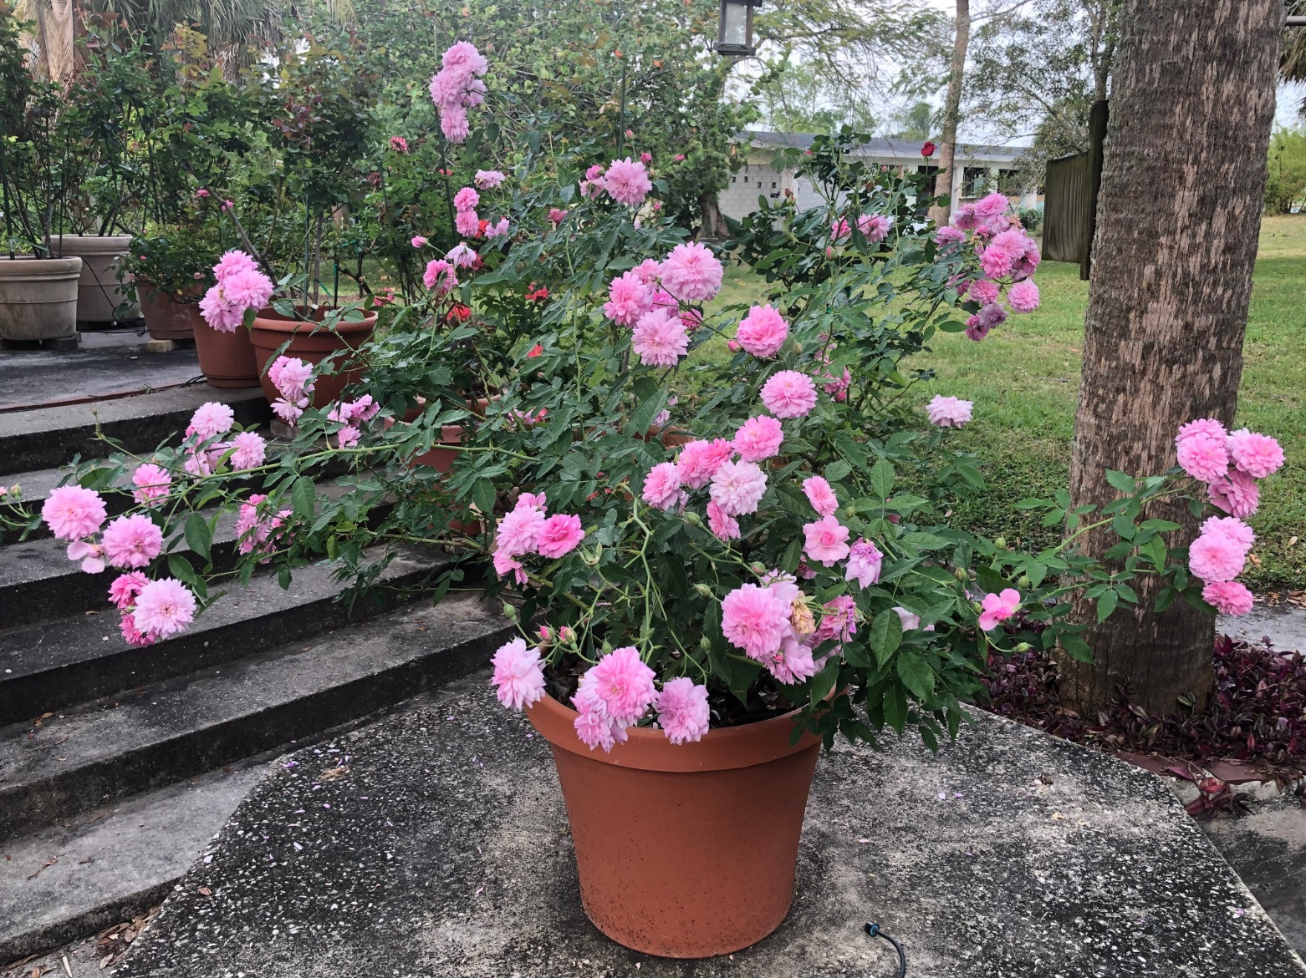
Rose Tips
Roses grow year-round in south Florida.
They do not go dormant like they do up north.
They bloom all year, but the best blooms are found November to May, when the weather is milder.
When the weather is hot the blooms develop so fast (from bud-to-fully open), they do not have time to get large. It is common to see fewer petals in a bloom in the summer than in the winter.
Prune in January or February for best results.
In the summer maintain as much foliage on the bushes as possible.
Pink Pet (aka Caldwell Pink) OGR – China 1928

Slide 10
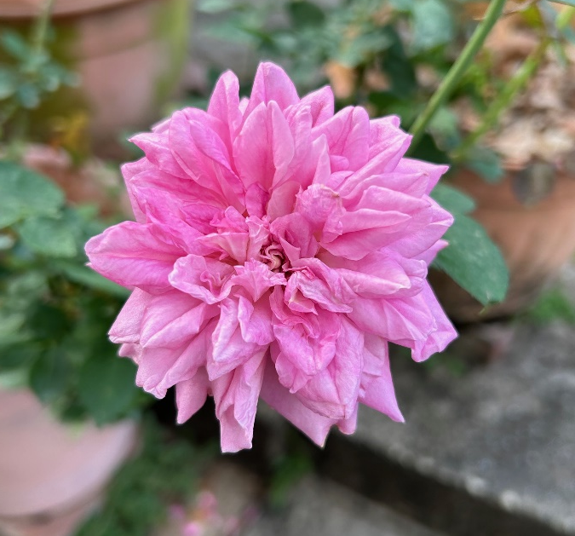
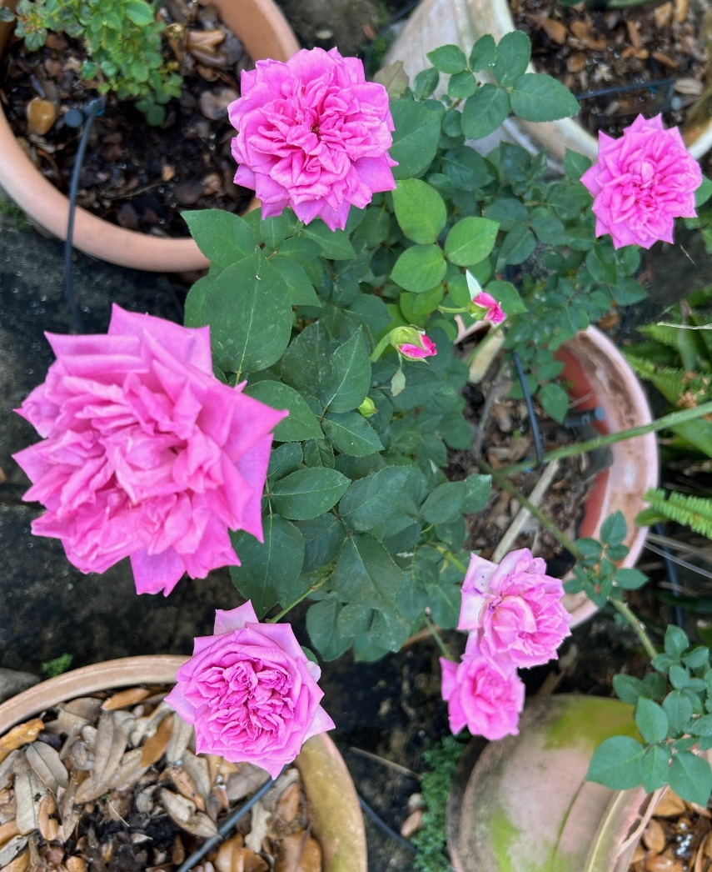

Leweson-Gower OGR – Bourbon 1845

Slide 11
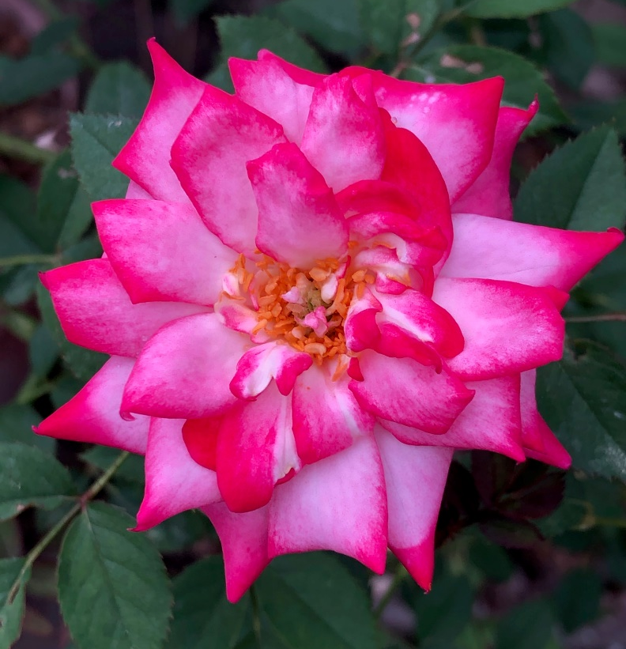
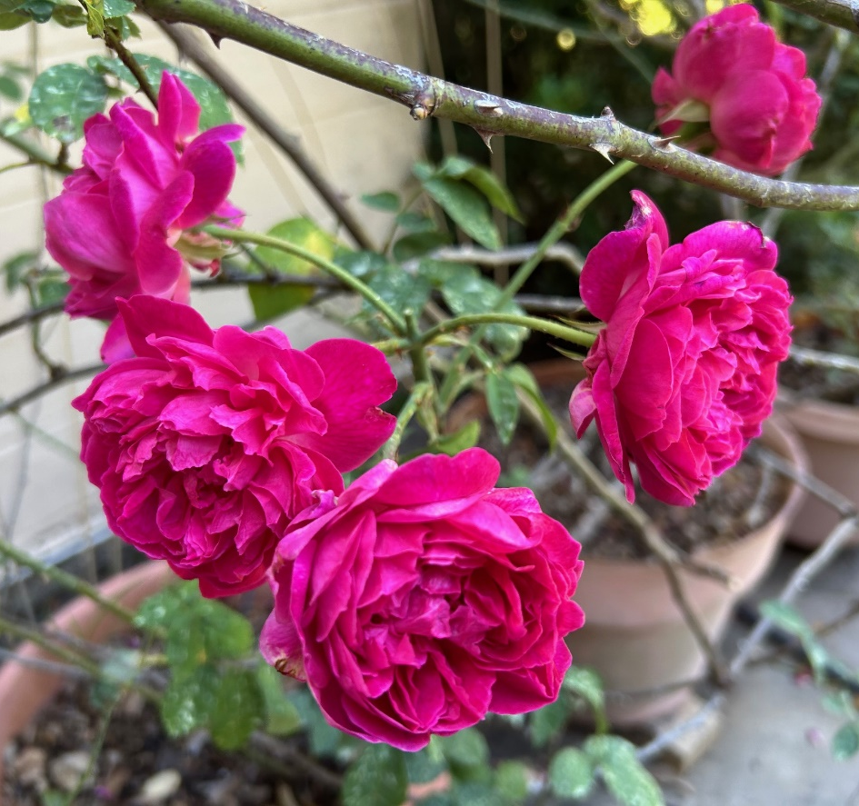
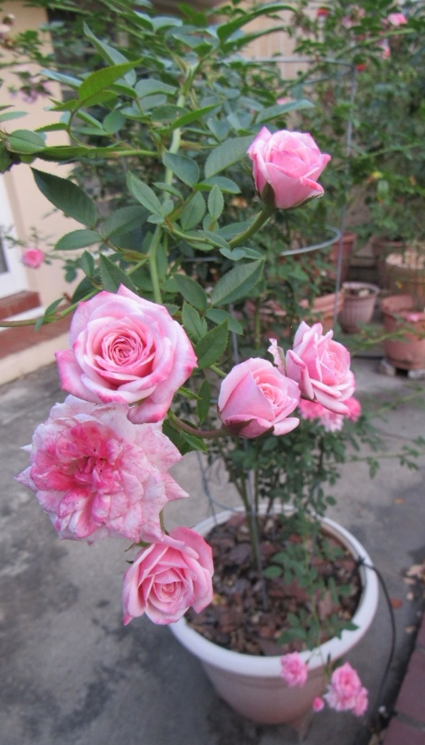

Rose Come in All Types
Sweet Caroline
Miniature Rose
Maggie – OGR - Bourbon
Jeanne Lajoie
Climbing Miniature

Slide 12
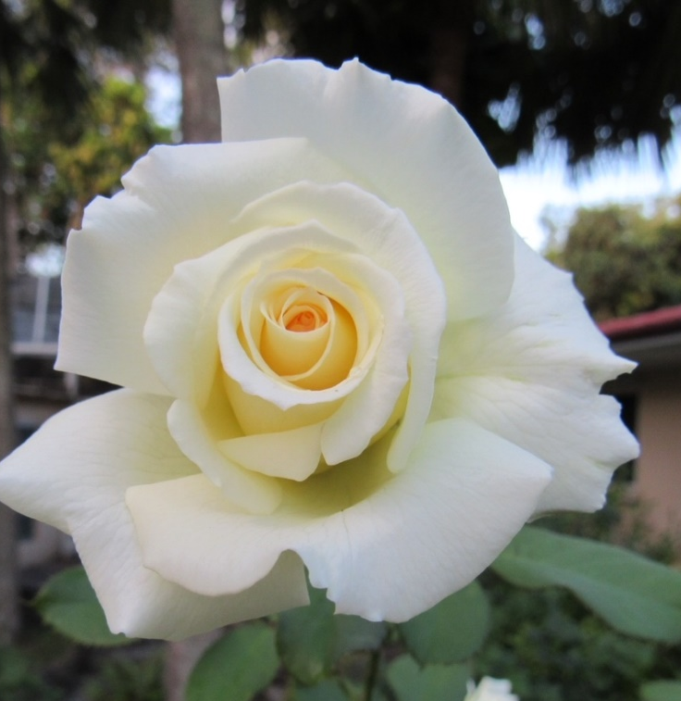
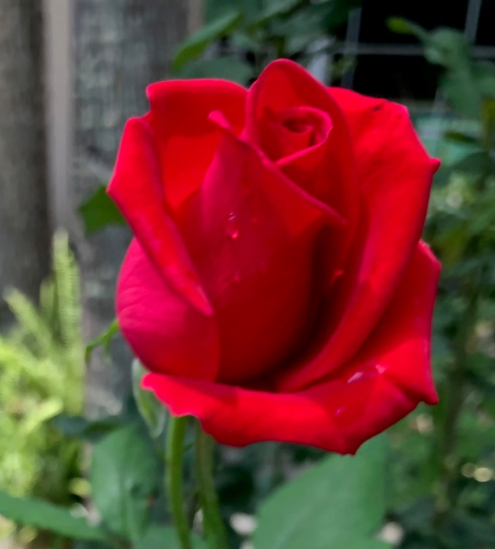

A Few of my Favorite Hybrid Teas
Pope John Paul II
Veterans’ Honor
St. Patrick

